Slide 1
Data Mining
Lecture 10

Slide 2
Course Syllabus
Classification Techniques (Week 7- Week 8- Week 9)
  Inductive Learning
  Decision Tree Learning
  Association Rules
  Neural Networks
  Regression
  Probabilistic Reasoning
  Bayesian Learning
Case Study 4: Working and experiencing on the properties of the classification infrastructure of Propensity Score Card System for The Retail Banking (Assignment 4) Week 9

Slide 3

Bayesian Learning
Bayes theorem is the cornerstone of Bayesian learning methods because it provides a way to calculate the posterior probability P(hlD), from the prior probability P(h), together with P(D) and P(D/h)

Slide 4
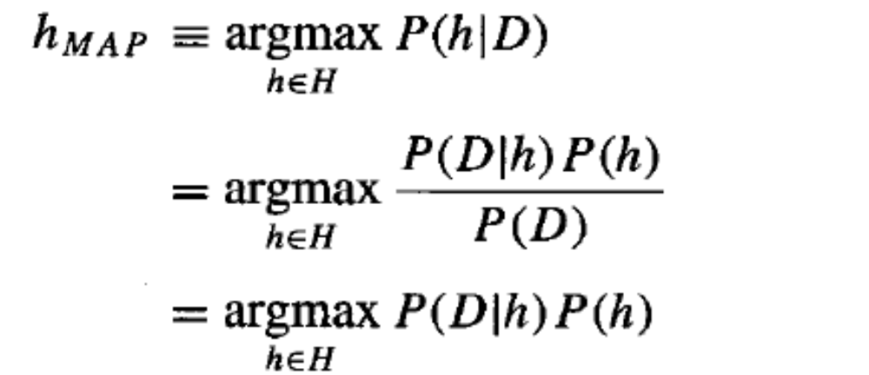
Bayesian Learning
finding the most probable hypothesis h E H given the observed data D (or at least one of the maximally probable if there are several). Any such maximally probable hypothesis is called a maximum a posteriori (MAP) hypothesis. We can determine the MAP hypotheses by using Bayes theorem to calculate the posterior probability of each candidate hypothesis. More precisely, we will say that MAP is a MAP hypothesis provided (in the last line we dropped the term P(D) because it is a constant independent of h)

Slide 5
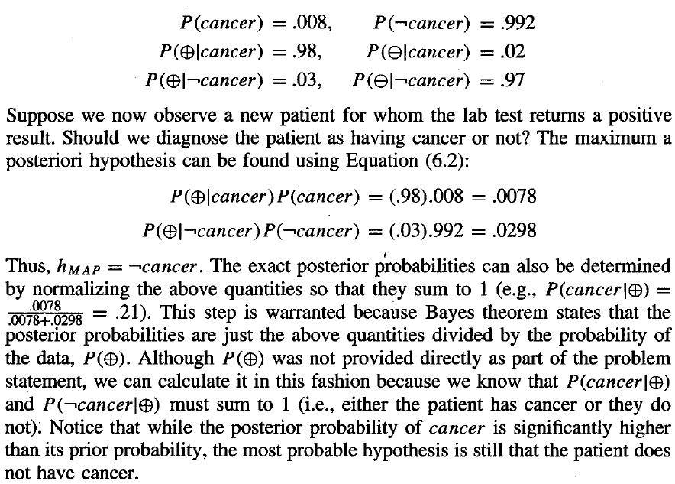
Bayesian Learning

Slide 6
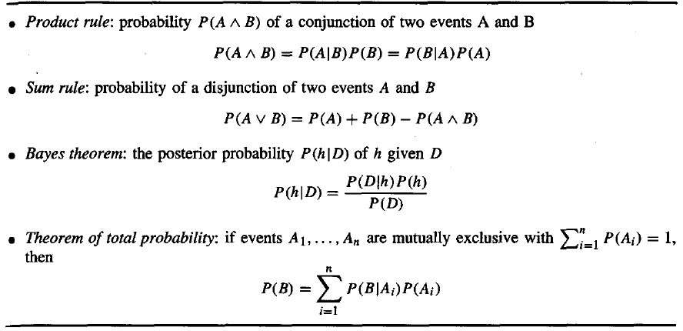
Probability Rules

Slide 7
Neural Networks
Highly interconnected with probabilistic reasoning concepts
The study of artificial neural networks (ANNs) has been inspired in part by the observation that biological learning systems are built of very complex webs of interconnected neurons

Slide 8
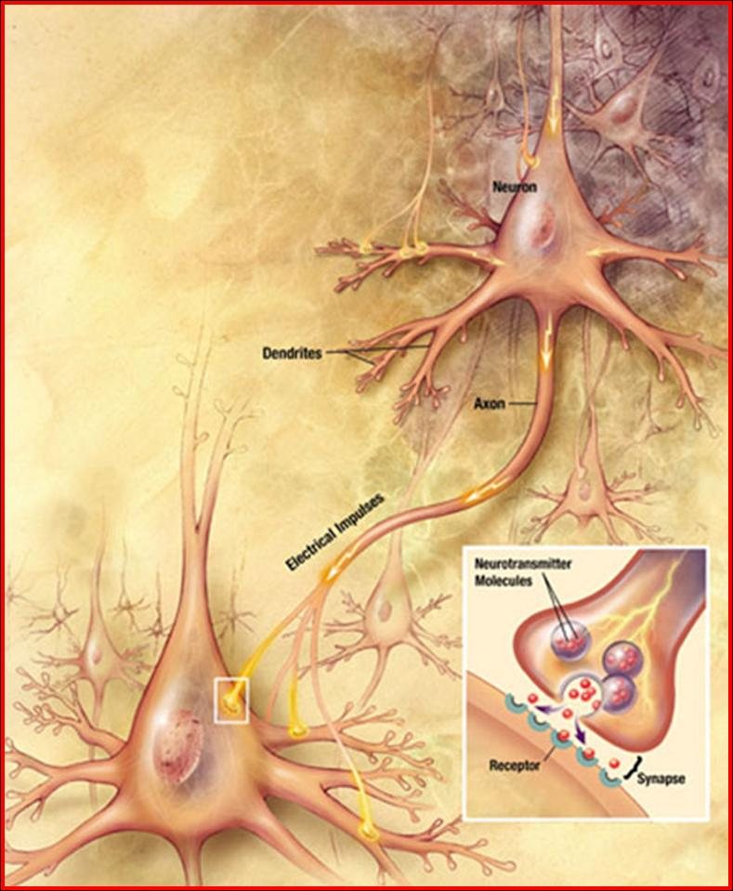
Neural Networks

Slide 9
Neural Networks
Chemical activations are very slow comparing digital activations; but power of parallel-distributed computation comes in
Although it has many weaknesses such as
  Not really parallel and distributed
  Training is much more slower
  Suffers from local minima problem
  Requires predefined topology estimation (number of neurons, number of hidden layers)...
  Lack of interpretation and explanation
  but it has many advantages
  it is robust to noise and error
  data type independent and open
  multi output value predictibility...

Slide 10
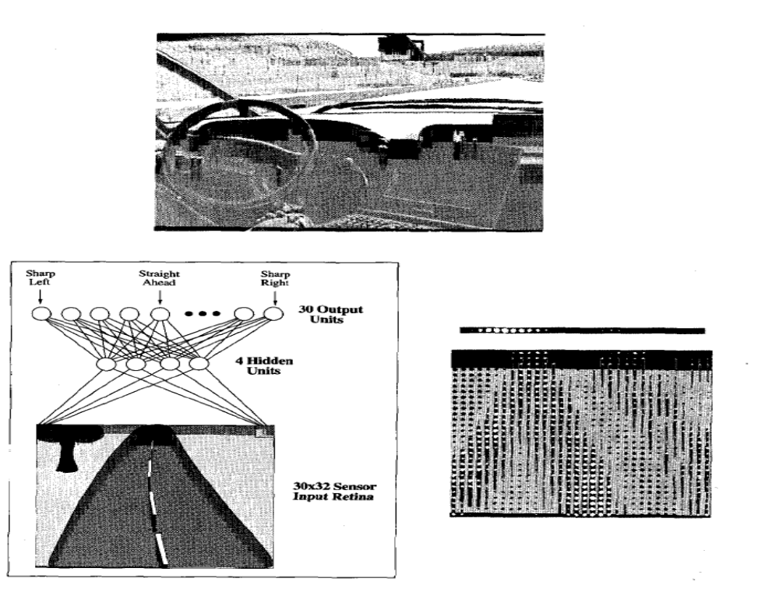
Neural Networks
ALVINN Neural
Network based
Autonomous
Vehicle

Slide 11
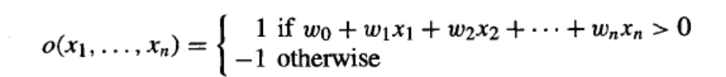
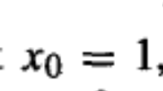

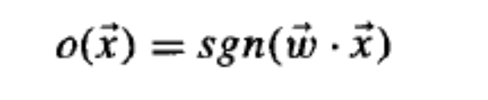
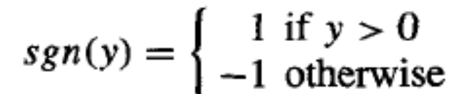
Neural Networks- Perceptrons
A perceptron takes a vector of real-valued inputs, calculates a linear combination of these inputs, then outputs a 1 if the result is greater than some threshold and -1 otherwise.
Or in vector notation
H is candidate hypotheses considered in perceptron learning is the set of all possible real-valued weight vector
where

Slide 12
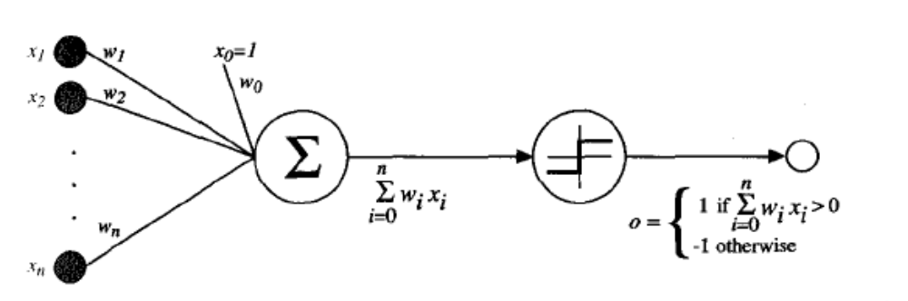
Neural Networks- Perceptrons
A perceptron takes a vector of real-valued inputs, calculates a linear combination of these inputs, then outputs a 1 if the result is greater than some threshold and -1 otherwise.

Slide 13
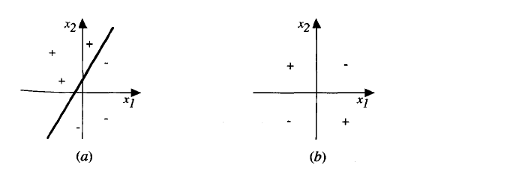
Neural Networks- Perceptrons
single perceptron can be used to represent many boolean functions such as AND, OR, NAND, NOR
but single perceptron can not represent XOR (because it is not LINEARLY SEPERABLE)
a-) single perceptron’s decision surface
b-) XOR function’s decision surface

Slide 14


Single Perceptron Training Rule
Learning is actually weight tuning and adjusting;
for every weights in the system:
delta factor must decrease the gap between system’s
Output value and desired/target value; so:
t is the target output for the current training example,
o is the output generated by the perceptron
and is a positive constant called the learning rate

Slide 15
Single Perceptron Training Rule
Learning is actually weight tuning and adjusting;
for every weights in the system:
delta factor must decrease the gap between system’s
Output value and desired/target value; so:
t is the target output for the current training example,
o is the output generated by the perceptron
and is a positive constant called the learning rate
provided the training examples are linearly separable and sufficiently small learning rate is used training rule convergence assured

Slide 16

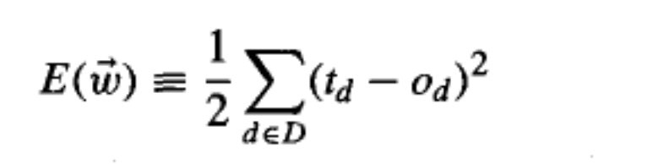
Delta Training Rule
The delta training rule is best understood by considering
the task of training an unthresholded perceptron; that is,
a linear unit for which the output o is given by
specifying a measure for the training error of a hypothesis (weight vector), relative to the training examples, one convenient way is
Bayesian Approach will show us that under certain conditions the hypothesis that minimizes E is also the most probable hypothesis in H given the training data

Slide 17
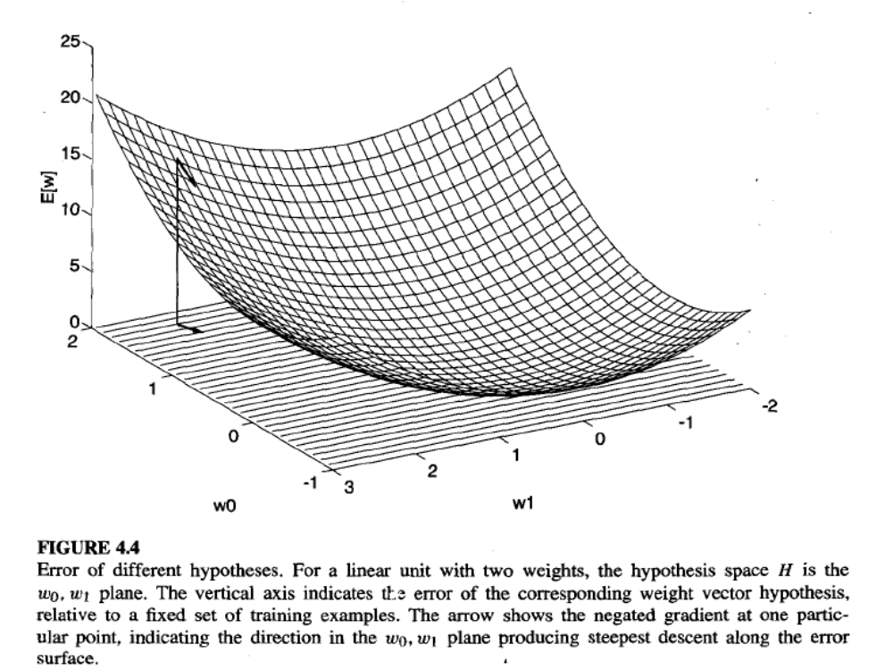
Delta Training Rule

Slide 18
Delta Training Rule
Gradient descent search determines a weight vector that minimizes E by starting with an arbitrary initial weight vector, then repeatedly modifying it in small steps until the global minimum error is reached
How can we calculate the direction of steepest descent along the error surface? This direction can be found by computing the derivative of E with respect to each weight component of the vector

Slide 19
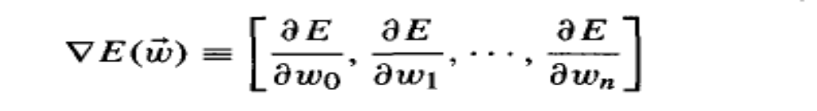


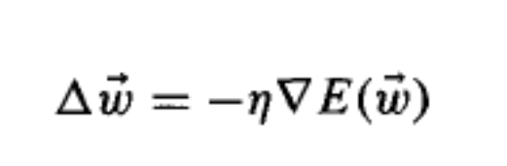
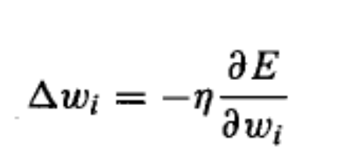
Delta Training Rule
is itself a vector, whose components are the partial derivatives of E with respect to each of the wi. When interpreted as a vector in weightspace, the gradient specifies the direction that produces the steepest increase in E. The negative of this vector therefore gives the direction of steepest decrease
Where delta factor is
,

Slide 20
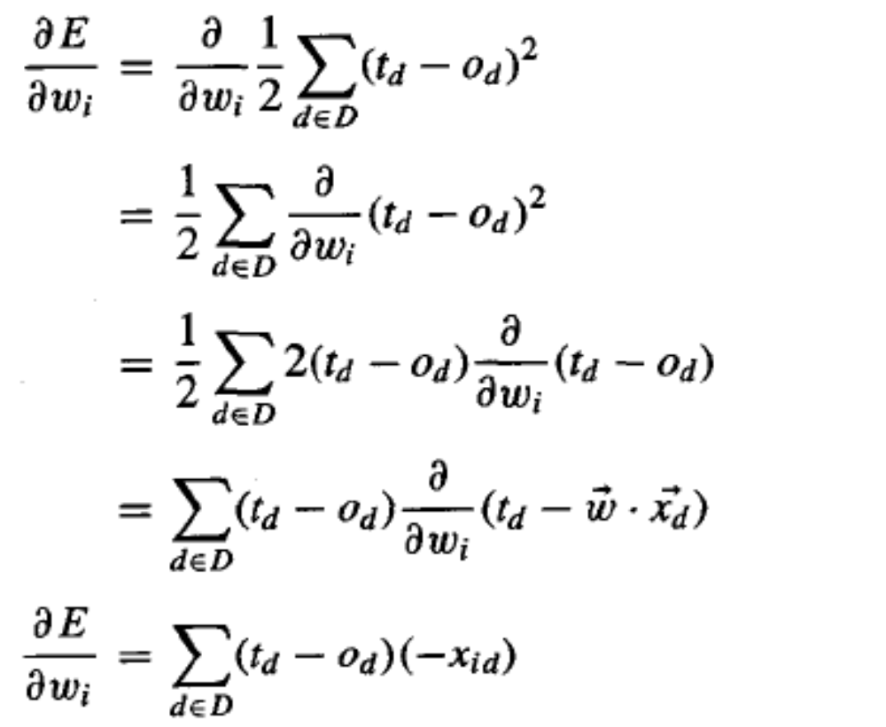
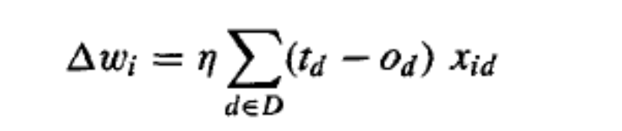
Delta Training Rule

Slide 21
Delta Training Rule
Because the error surface contains only a single global minimum (but we are assuming linear unit), this algorithm will converge to a weight vector with minimum error, regardless of whether the training examples are linearly separable, given a sufficiently small learning rate is used. If learning rate is too large, the gradient descent search runs the risk of overstepping the minimum in the error surface rather than settling into it.
one common modification to the algorithm is to gradually reduce the value of learning rate as the number of gradient descent steps grows.

Slide 22
Delta Training Rule
Gradient descent is an important general paradigm for learning. It is a strategy for searching through a large or infinite hypothesis space that can be applied whenever
the hypothesis space contains continuously parameterized hypotheses (e.g., the weights in a linear unit),
the error can be differentiated with respect to these hypothesis parameters.
The key practical difficulties in applying gradient descent are converging to a local minimum can sometimes be quite slow (i.e., it can require many thousands of gradient descent steps), and if there are multiple local minima in the error surface, then there is no guarantee that the procedure will find the global minimum.

Slide 23
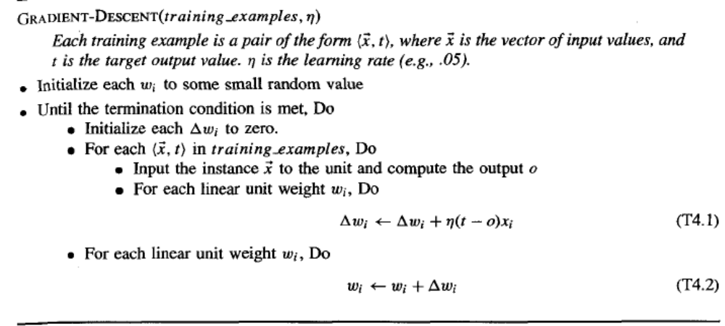
Delta Training Rule

Slide 24
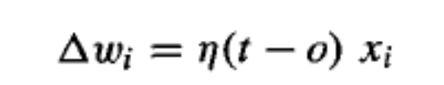
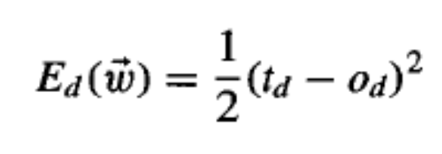
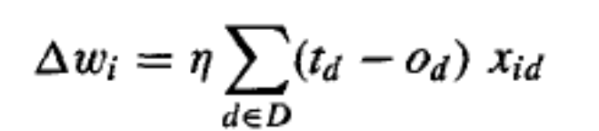

Stochastic Delta Training Rule
incremental gradient descent, or alternatively stochastic gradient
descent except that as we iterate through each training example
we update the weight according to
actually stochastic error function that we minimize is
Gradient Descent
Stochastic Gradient Descent

Slide 25
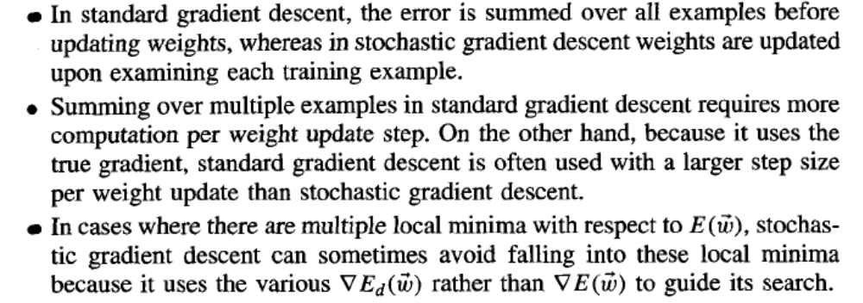
Stochastic vs. Gradient

Slide 26


Perceptron vs. Delta
Delta
Perceptron
Can delta rule be used for perceptron learning? Yes, if we wish to train a
perceptron to fit training examples with target values of +/- 1 for o', we can
use these same target values and examples to train o instead, using the
delta rule. Clearly, if the unthresholded output o can be trained to fit these
values perfectly, then the threshold output of will fit them as well
(because sgn(1) = 1,and sgn(-1) = -1). Even when the target values
cannot be fit perfectly, the thresholded o value will correctly fit the target
value whenever the linear unit output o has the correct sign. Notice, however,
that while this procedure will learn weights that minimize the error in the
linear unit output o, these weights will not necessarily minimize the number
of training examples misclassified by the thresholded output o'

Slide 27
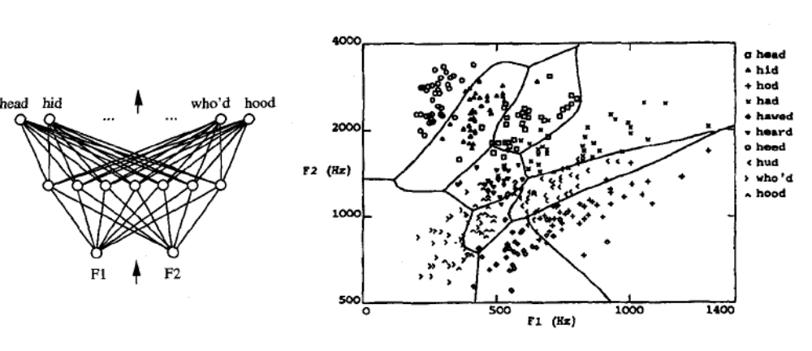
Perceptron vs. Delta
The perceptron training rule converges after a finite number of iterations to a hypothesis that perfectly classifies the training data, provided the training examples are linearly separable. The delta rule converges only asymptotically toward the minimum error hypothesis, possibly requiring unbounded time, but converges regardless of whether the training data are linearly separable.
One single perceptron can only represent linearly seperable functions;on the other
hand, multi-layered perceptrons can represent non linear, contionous, unbounded
Functions. XOR case can be solved with two –layered perceptron network

Slide 28
Perceptron vs. Delta
multiple layers of cascaded linear units still produce only linear functions, and we prefer networks capable of representing highly nonlinear functions. The perceptron unit is another possible choice, but its discontinuous threshold makes it undifferentiable and hence unsuitable for gradient descent
What we need is a unit whose output is a nonlinear function of its inputs, but whose output is also a differentiable function of its inputs

Slide 29
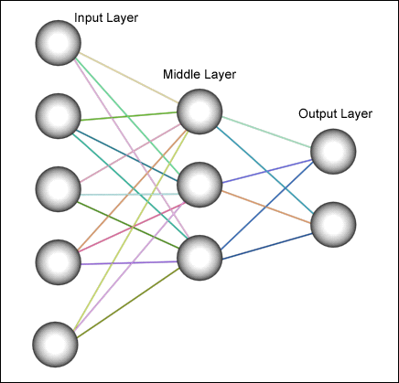
Multilayer Networks

Slide 30
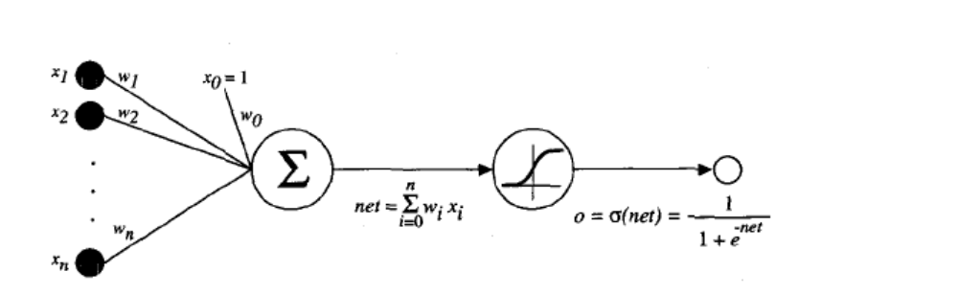
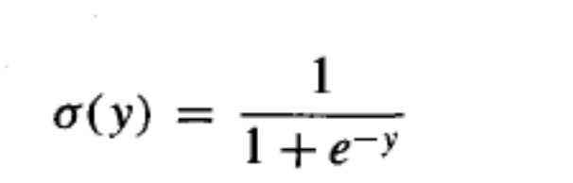
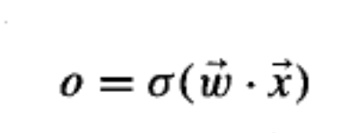
Multilayer Networks

Slide 31
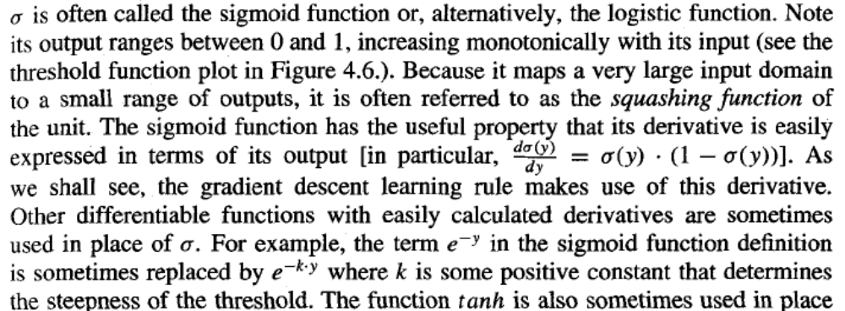
Multilayer Networks

Slide 32
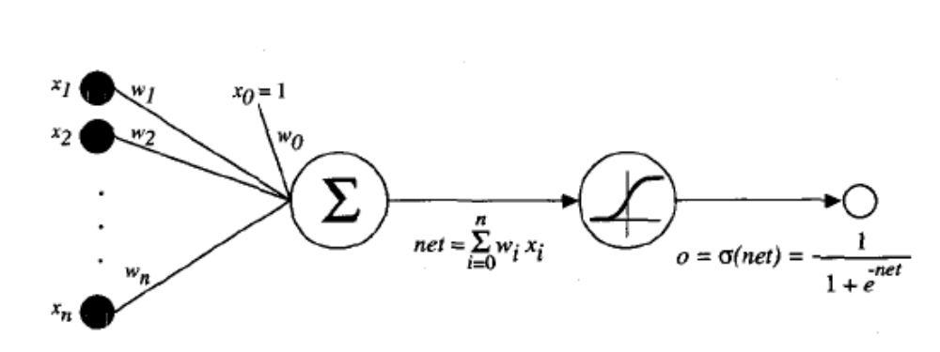


Multilayer Networks
Let’s derive the learning rule for stochastic gradient
descent

Slide 33
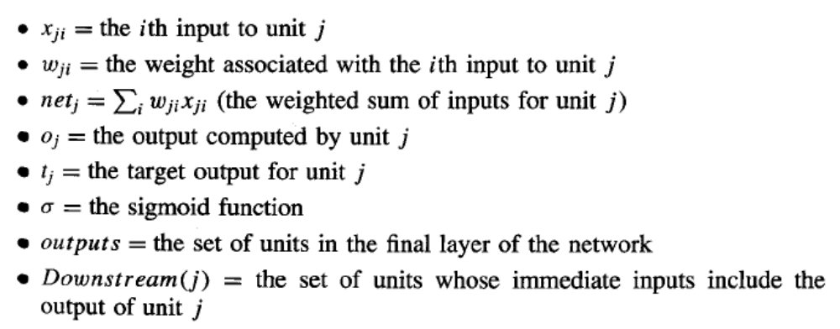
Multilayer Networks

Slide 34
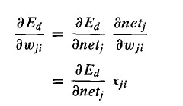
Multilayer Networks
we need to compute
by chain rule
we need to compute

Slide 35
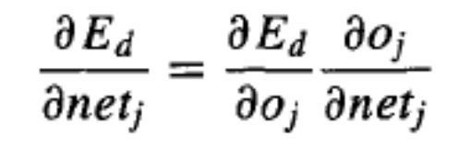
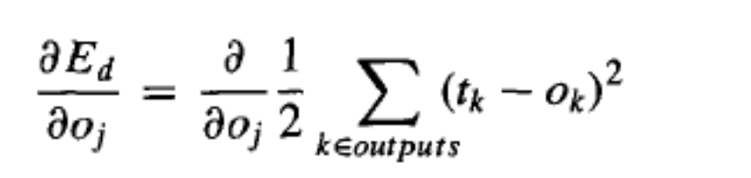

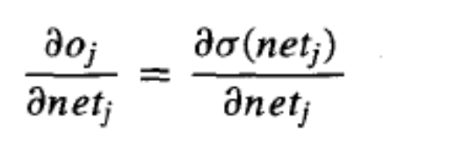
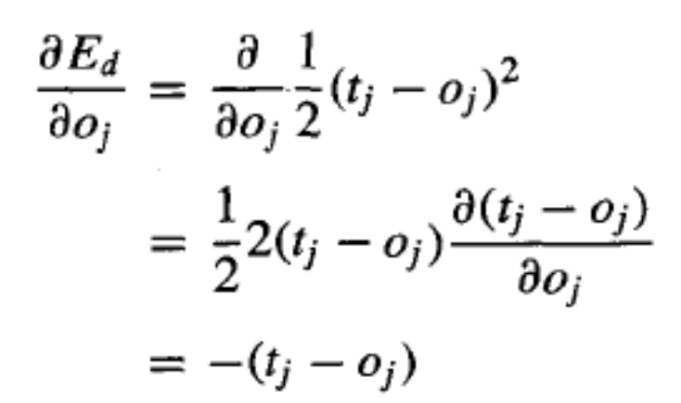
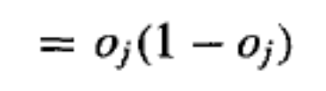
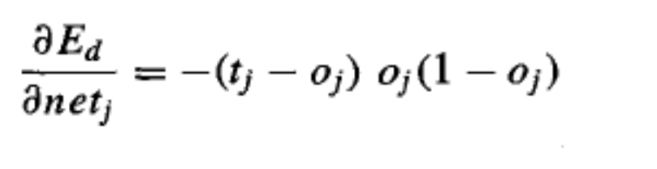
Multilayer Networks
Case 1: Training Rule for Output Unit Weights =
comes from
our sigmoid
function

Slide 36
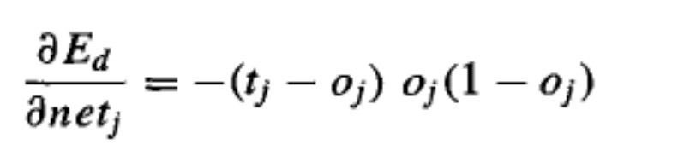
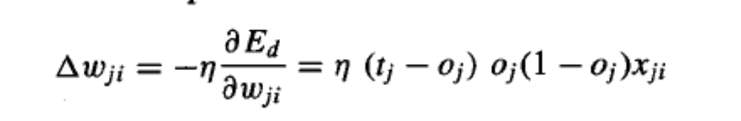
Multilayer Networks
Case 1: Training Rule for Output Unit Weights =

Slide 37

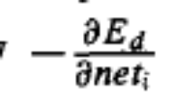
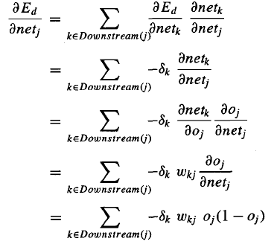


Multilayer Networks
Case 2: Training Rule for Hidden Unit Weights =
denotes

Slide 38
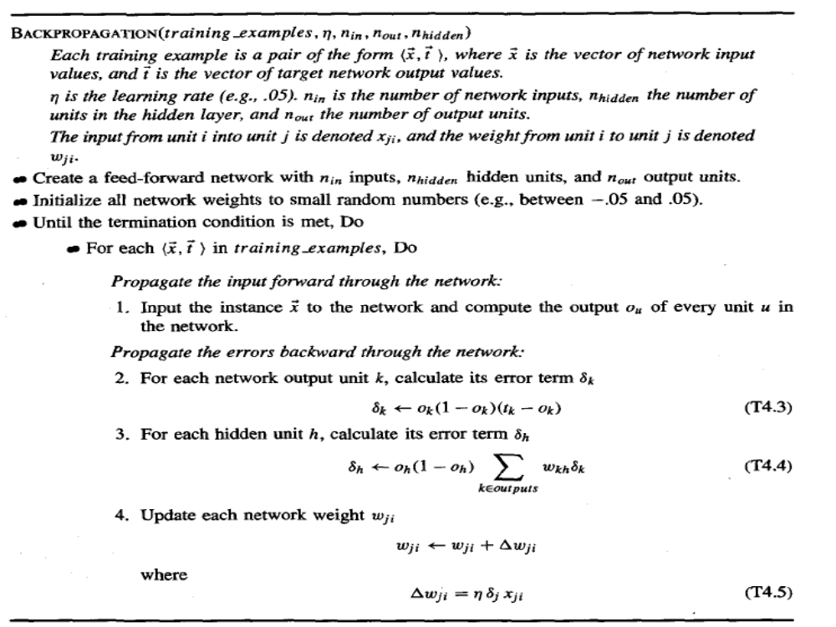
Multilayer Networks

Slide 39

Remarks on Backpropogation
One major difference in the case of multilayer networks is that the error surface can have multiple local minima, in contrast to the single-minimum parabolic error surface. Unfortunately, this means that gradient descent is guaranteed only to converge toward some local minimum, and not necessarily the global minimum error. Despite this obstacle, in practice BACKPROPAGATION been found to produce excellent results in many real-world applications
The algorithm seen in this presentation updates weights incrementally, following the presentation of each training example. This corresponds to a stochastic approximation to gradient descent. To obtain the true gradient of E one would sum the values over all training examples before altering weight values.
Termination criterias:
to halt after a fixed number of iterations through the loop,
once the error on the training examples falls below some threshold
once the error on a separate validation set of examples meets some
criterion. The choice of termination criterion is an important one, because too few iterations can fail to reduce error sufficiently, and too many can lead to overfitting the training data

Slide 40
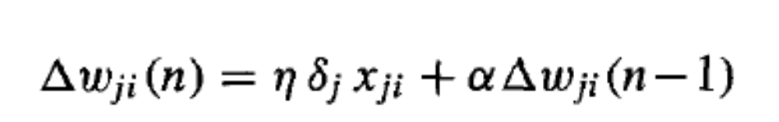
Local Minima Solutions
Add a momentum term to the weight-update rule. Momentum can sometimes carry the gradient dscent procedure through narrow local minima (though in principle it can also carry it through narrow global minima into other local minima!).
Use stochastic gradient descent rather than true gradient descent. the stochastic approximation to gradient descent effectively descends a different error surface for each training example, relying on the average of these to approximate the gradient with respect to the full training set. These different error surfaces typically will have different local minima, making it less likely that the process will get stuck in any one of them.
Train multiple networks using the same data, but initializing each network with different random weights. If the different training efforts lead to different local minima, then the network with the best performance over a
separate validation data set can be selected. Alternatively, all networks can
be retained and treated as a "committee" of networks whose output is the
(possibly weighted) average of the individual network outputs.

Slide 41
Functional Representation
Boolean functions. Every boolean function can be represented exactly by some network with two layers of units, although the number of hidden units required grows exponentially in the worst case with the number of network inputs. To see how this can be done, consider the following general scheme for representing an arbitrary boolean function: For each possible input vector, create a distinct hidden unit and set its weights so that it activates if and only if this specific vector is input to the network. This produces a hidden layer that will always have exactly one unit active. Now implement the output unit as an OR gate that activates just for the desired input patterns.

Slide 42
Functional Representation
Continuous functions. Every bounded continuous function can be approximated with arbitrarily small error (under a finite norm) by a network with two layers of units (Cybenko 1989; Hornik et al. 1989). The theorem in this case applies to networks that use sigmoid units at the hidden layer and (unthresholded) linear units at the output layer. The number of hidden units required depends on the function to be approximated.

Slide 43
Functional Representation
Arbitraryfunctions. Any function can be approximated to arbitrary accuracy
by a network with three layers of units (Cybenko 1988). Again, the output
layer uses linear units, the two hidden layers use sigmoid units, and the
number of units required at each layer is not known in general. The proof
of this involves showing that any function can be approximated by a linear
combination of many localized functions that have value 0 everywhere
except for some small region, and then showing that two layers of sigmoid
units are sufficient to produce good local approximations.

Slide 44
Inductive Bias
What is the inductive bias by which BACKPROPAGATION
neralizes beyond the observed data?
It is difficult to characterize precisely the inductive bias of BACKPROPAGATlON, because it depends on the interplay between the gradient descent search and the way in which the weight space spans the space of representable functions. However, one can roughly characterize it as smooth interpolation between data points. Given two positive training examples with no negative examples between them, system wil always classify unseen instances as “positive”

Slide 45
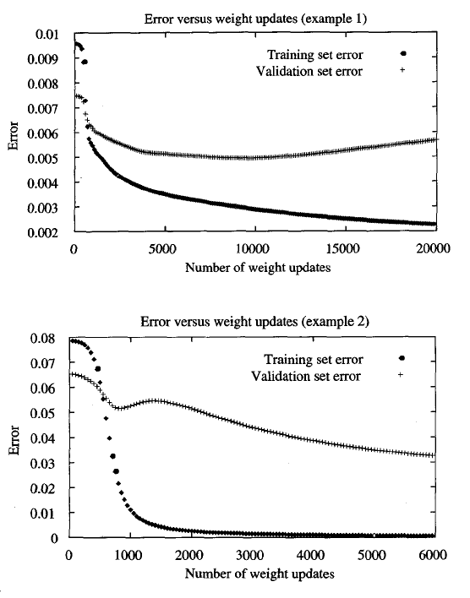
Generalization vs. Overfitting

Slide 46
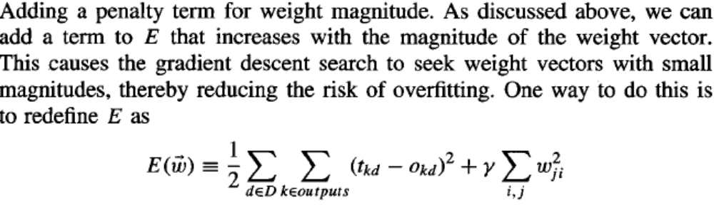
Detailed Topics...

Slide 47
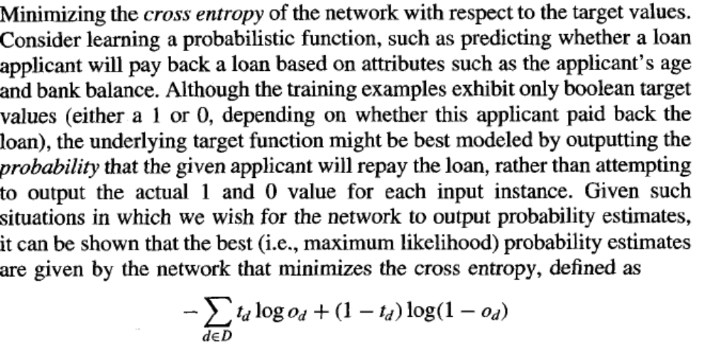
Detailed Topics...

Slide 48
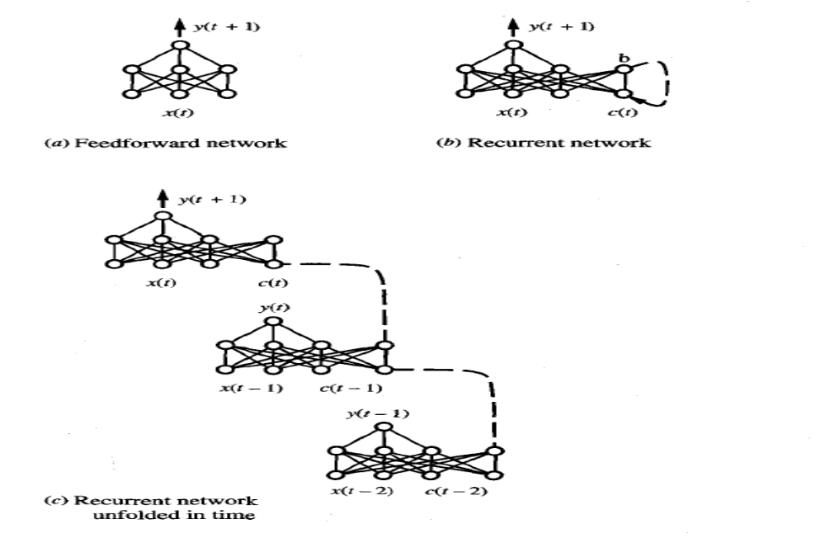
Detailed Topics _ Recurrent Networks

Slide 49
Detailed Topics _Alternative Error Minimization Techniques
line search, involves a different approach to choosing the distance for the weight update. In particular, once a line is chosen that specifies the direction of the update, the update distance is chosen by finding the minimum of the error function along this line. Notice this can result in a very large or very small weight update, depending on the position of the point along the line that minimizes error.
conjugate gradient method. a sequence of line searches is performed to search for a minimum in the error surface. On the first step in this sequence, the direction chosen is the negative of the gradient. On each subsequent step, a new direction is chosen so that the component of the error gradient that has just been made zero, remains zero.

Slide 50
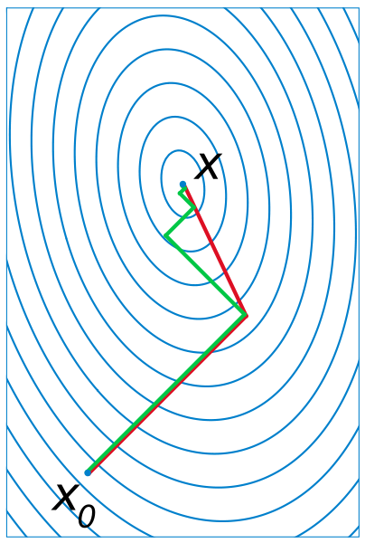
Conjugate Gradient

Slide 51
Detailed Topics _Network Topology Estimation
Strategy 1: (after topology correction)
use predefined topology parameters; train the network, after training discard the connections associate with lower weigths, repeat same process again again till weigths are greater than some predefined threshold
Strategy 2: (before topology correction)
start with minimal number of neurons and minimum number of layer parameters; when trainins success rate is not satisfied then increment gradually number of neurons and number of layers
Strategy 3:
use genetic algorithms to find best topology parameters

Slide 52
End of Lecture
read Chapter 6 of Course Text Book
read Chapter 6 – Supplemantary Text Book “Machine Learning” – Tom Mitchell
Assignment 4, use Weka and choose an appropriate data set for Decision Tree Learning, write technical report that mentions about the technical issues of your case
Assignment 5, use Weka and choose an appropriate data set for Neural Network Learning, write technical report that mentions about the technical issues of your case

